Slide 1
Testing! We’re Talking About (Unit) Testing
Dan Mallott

Slide 2
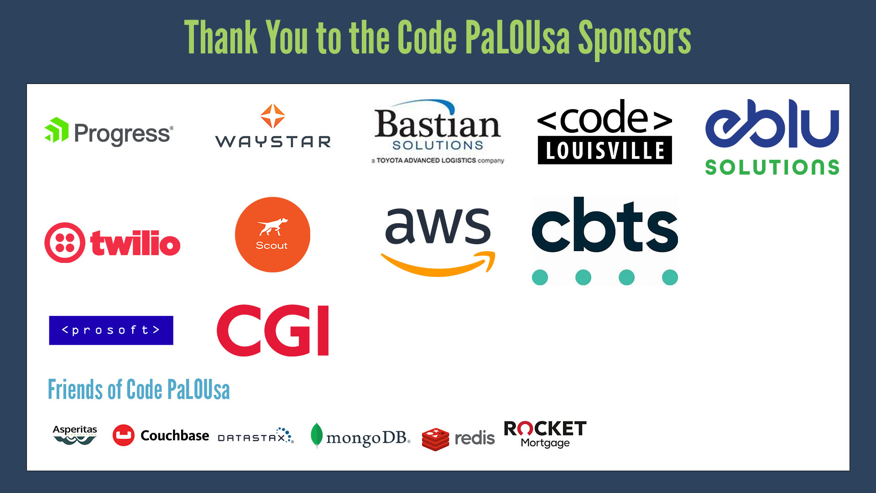

Slide 3

Dan Mallott
Senior Principal in Product Engineering at West Monroe
Based in Chicago, USA
> 10 years experience as a DBA and Developer
Mostly Microsoft technologies (.NET, SQL Server, Azure)
Ice Hockey Official

Slide 4
What is Unit Testing?
In computer programming, unit testing is a software testing method by which individual unit of source code – sets of one or more computer program modules together with associated control data, usage procedures, and operating procedures – are tested to determine whether they are fit for use.
A Unit Test is an automated piece of code that invokes a unit of work in a system and then checks a single assumption about the behavior of that unit of work.
A unit test is a way of testing a unit – the smallest piece of code that can be logically isolated in a system.
Unit Testing, also known as Component Testing, is a level of software testing where individual units/components of a software are tested

Slide 5
Why Unit Testing? Why Not Unit Testing?
Why Unit Testing?
Why Not Unit Testing?
Find logical issues early
Creates a code contract that protects against changes
Ensures adherence to acceptance criteria
Provides living documentation of how the code is meant to be consumed
Does not catch integration issues
Can be difficult to set up realistic unit tests
Adds extra development effort – sometimes more than twice as much as the initial code
Requires tests to be run to be effective

Slide 6
What Are The Characteristics of Unit Tests?
1
Unit Tests are automated
2
Unit Tests are granular
3
Unit Tests isolate their target
4
Unit Tests are deterministic
5
Unit Tests are independent
6
Unit Tests are fast

Slide 7
So, What Does a Unit Test Look Like?

Slide 8

Say We Have a Basic Function:

Slide 9
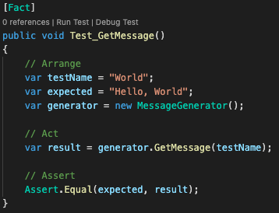
We Can Unit Test It Like This:

Slide 10
But That Obviously Wasn’t T-SQL

Slide 11
Should We Be Unit Testing Our T-SQL Code?

Slide 12
Database Unit Testing?
Do You Have Business Logic In Your Database? Could Be Stored Procedures, Defaults, Computed Columns…
Is It Tested When You First Develop It? How About Against Regressions?
You Should (Strongly) Consider Unit Testing!

Slide 13
What Does a Database Unit Test Look Like? (AKA Demo Time)

Slide 14
OTHER Database Unit Testing Frameworks
dbUnit
DbFit
SQL Test
NoSQLUnit

Slide 15
Now That We Have a Framework, Can We Automate This?

Slide 16
Absolutely! Just Add Your Favorite CI/CD Tool (and Maybe a Dash of PowerShell)!

Slide 17
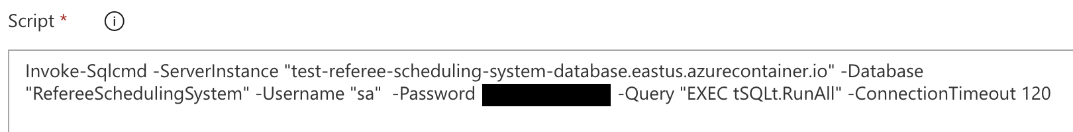
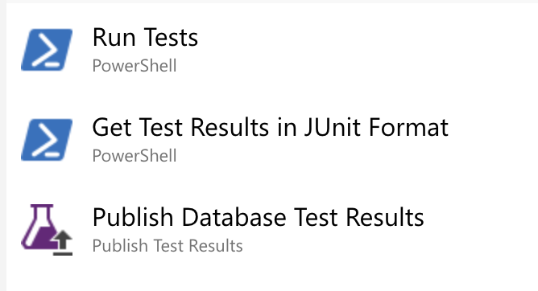
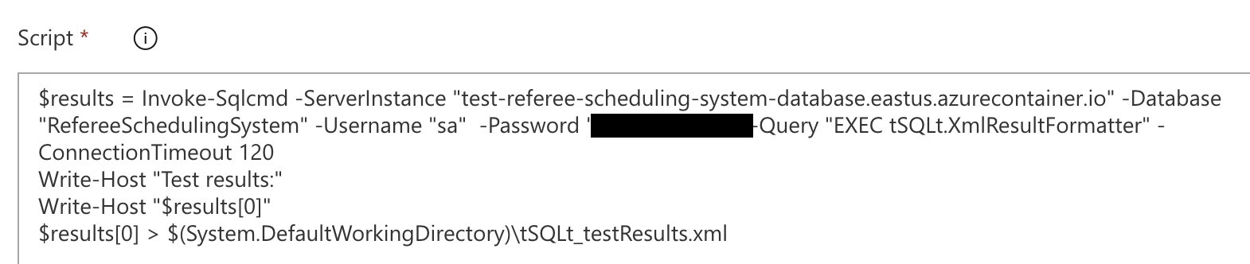
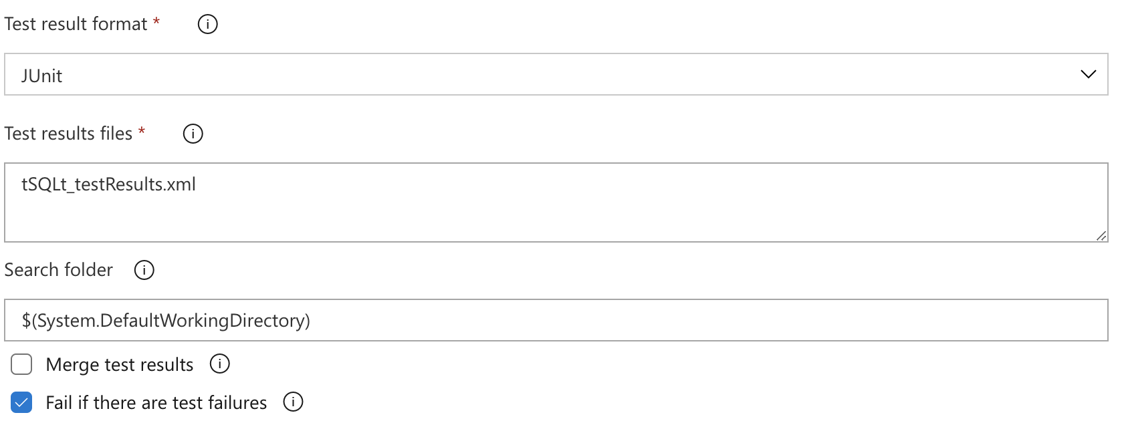
What About Automation?

Slide 18
Questions?

Slide 19
Thank You!
@danielmallott
linkedin.com/in/danielmallott
dmallott@westmonroe.com

